Slide 1
Automatic Detection of Estonian Argument Structure Constructions on the Example of Caused-Motion Verbs
Kertu Saul, Jelena Kallas, Kadri Muischnek
Institute of the Estonian Language, University of Tartu

Slide 2
Argument Structure Construction
Construction: form-meaning pair
Constructions that consist of a verb and its arguments, e.g caused-motion construction
nsubj V obj obl+case
AGENT VERB PATIENT GOAL
Peter threw the ball to Tom.
He sneezed the napkin off the table.

Slide 3
About Estonian
Free word order
Morphologically very rich, 14 nominal cases
Arguments can be in most cases
Cases are very polyfunctional
Lubja-l kadu-s eile õhtu-l 80 protsendi-l elanike-l elekter.
Lubja-ADE disappear-3SG.PST yesterday night-ADE 80 percent-ADE resident.PL-ADE electricity
“Electricity disappeared for 80 percent of residents in Lubja yesterday night”

Slide 4
What we did
Create preliminary workflow for automatically detecting argument structures from UD annotated corpora
Test it on caused-motion verbs
Find primary problems associated with detecting argument structures in Estonian
Offer solutions to implement in future work

Slide 5
Why and for whom?
WP2 - lexicon-corpus interface
  PRG1978 - adding constructions to dictionaries
  manually made lists of argument structures might not reflect actual usage
  manual compilation too time-consuming and expensive
WP3 - multilingual language technology
  creating a method that’s easy to implement for other languages
  argument structures help improve and develop syntactic and semantic parsers
WP4 - language diversity
  expanding argument structure detection to smaller, non-Indo-European languages

Slide 6
Similar work on detecting constructions
Automatic constructicon (Dunn 2023; Forsberg et al 2014)
  Word forms + POS + semantic clusters/phrase structures
  Various statistical methods: k-means clustering, Ripple Down Rules algorithm, PMI
  Problem: only fragments of complete sentences
Modelling language acquisition by finding constructions (Doumen et al 2024)
  Replace differences in similar form-meaning pairs with a slot
  Problem: requires semantic annotation, simple synthetic input data, only tested on English

Slide 7
Similar work on detecting argument structures
Using lexica and clustering (Marchal & Poibeau 2016; Chaminade & Poibeau 2017)
  Cluster minimal sentences until only one remains for each verb sense
  Japanese, Finnish
  Problem: fully lexical, lots of idioms and frozen expressions
Using UD: UDLex (Rambelli et al 2017)
  Find argument structure constructions, which verbs use which frequently, add lexica and Wordnet supersenses to each argument slot
  Quality: argument structures’ recall 51-63%, precision 37-55%
  Problem: only accounts for Indo-European languages (English, French, Italian)

Slide 8
Our method
Corpus of 15 million words - science, literature, press. Automatically annotated in UD framework
Extract each verb’s direct dependents as combinations of syntactic and morphological labels (ie oblique in adessive case)
  Filter out dependents with syntactic labels that can’t be arguments and verb forms that change argument structures
Calculate the frequency of each dependent and pair of dependents per verb
Filter out dependents and pairs that appear in less than 5% of that verb’s sentences
Combine remaining pairs into longer argument structures (a+b, a+c, b+c >5% = a+b+c)
Only retain each dependent’s longest argument structure

Slide 9
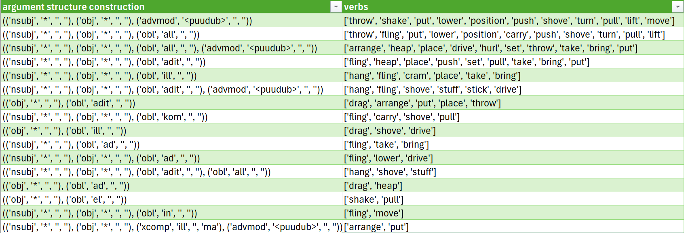
Results for 28 caused-motion verbs
107 verb specific argument structures
41 argument structure constructions

Slide 10
Quality
Manually compiled argument structures from a UD gold standard corpus
Arguments:
Recall: 81%
Precision: 74%
Argument structures:
Recall: 34%
Precision: 33%

Slide 11
Problems and solutions
Polyfunctionality of grammatical units: polyfunctionality makes obliques and adverbials too frequent and heterogeneous
  Oblique and adverbial dependents should be annotated with their semantic subclass.
Verb polysemy: argument structures belonging to a verb’s less frequent senses are not found
  Annotate verbs with meaning, detect argument structures by sense not by verb
Arguments can often be elliptic in corpus data and thus not identified
  Add default subject to non-zero-valent verbs
Phraseological verbs are not identified as single lexical units in the source data
  Integrate lexicons

Slide 12
New argument structures
Liigutama ‘move’: nsubj obj obl+ine
  AGENT PATIENT LOCATION
  Only used when the meaning of the verb is related to feelings
Mingi ähmane aimdus liiguta-s end Luige-s.
some vague hunch move-3SG.PST itself.PART Luik-INE
‘Some vague hunch moved itself in Luik.’
Pistma ‘put’: obj, obl+adit, obl+all
  PATIENT GOAL RECIPIENT
Üks õde-de-st pist-i-s mu-lle käe püksi.
one sister-PL-ELA put-PST-3SG I-ALL hand.GEN pants.ADDIT
‘One of the sisters put a hand in my pants.’

Slide 13
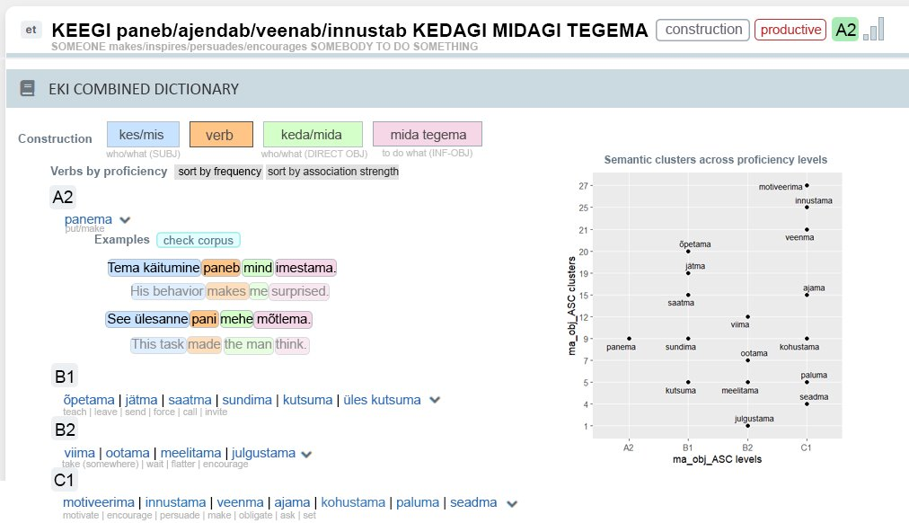

Slide 14
References
Rambelli, Giulia, Lenci, Alessandro, & Poibeau, Thierry 2017. UDLex: Towards cross-language subcategorization lexicons. In Fourth International Conference on Dependency Linguistics (Depling 2017).
Chaminade, Guersande and Thierry Poibeau 2017. Preliminary Experiments in the Extraction of Predicative Structures from a Large Finnish Corpus. In Proceedings of the Workshop 3rd International Workshop for Computational Linguistics of Uralic Language: 37–55.
Marchal, Pierre and Thierry Poibeau 2016. A Continuum-based Model of Lexical Acquisition. In CICLing Conference on Intelligent Text Processing and Computational Linguistics, Konya, Turkey, 2016
Dunn, Jonathan 2023. Exploring the Constructicon: Linguistic Analysis of a Computational CxG. In Proceedings of the First International Workshop on Construction Grammars and NLP (CxGs+NLP, GURT/SyntaxFest 2023), pages 1–11, Washington, D.C.. Association for Computational Linguistics
Doumen, Jonas, Katrien Beuls, Paul Van Eecke 2024. “Modelling constructivist language acquisition through syntactico-semantic pattern finding,” Royal Society Open Science, vol. 11, no. 7, Jul. 2024

Slide 15
